Slide 1



Library Management System
Mini Project (BCA 2nd Semester)
Palak Thakur | Roll No: 25BCA10103
BCA, Chandigarh University
Notes:
1

Slide 2
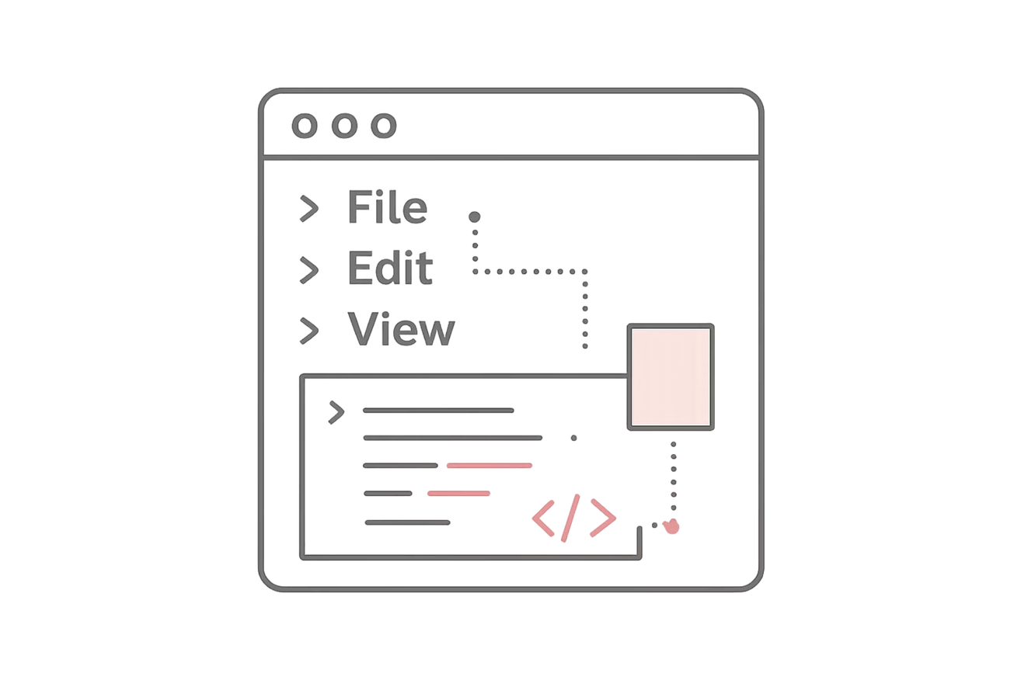
Project Overview
A simple Library Management System developed using C programming language. The system manages book records through organized tracking of availability and issuance.
Menu-driven interface allows users to add books, search records, issue and return books. Designed for learning purposes using linked lists and dynamic memory allocation.
Notes:
2

Slide 3




Project Objectives
Core Learning
Basic Operations
Understand dynamic memory allocation, pointers, and linked lists in C programming.
Implement adding, deleting, searching, issuing, and returning books.
Problem-Solving
Practical Skills
Improve logical thinking and understand program structure integration.
Gain hands-on experience writing structured code for real-world problems.
Notes:
3

Slide 4

Technology Stack
C Programming Language
Powerful language for understanding low-level memory management concepts.
CodeBlocks/Dev C++
Simple, easy-to-use compilers for Windows operating system.
Console Interface
Text-based interface for user interaction and menu selection.
Notes:
4

Slide 5

Data Structure Implementation
Linked List Approach
Each book represented as a node containing book ID, title, author, and issue status. Nodes connected using pointers for efficient traversal.
Dynamic Memory Allocation
Memory allocated when needed instead of predefined array size. Enables flexible insertion and deletion without data shifting.
Efficient Operations
Better memory usage and program efficiency through pointer-based connections between nodes.
Notes:
5

Slide 6




System Workflow
Menu Display
User Selection
Program starts showing user options
Choose operation from menu
Operation Execution
Continue or Exit
System processes selected task
Loop until exit option chosen
Operations include adding books (new node creation), displaying records (list traversal), searching by ID (node comparison), and managing issue status (data modification).
Notes:
6

Slide 7
Key Features
Add Books
Display All
Search by ID
Enter book details including ID, title, and author to create new records.
View all books in organized format with complete information.
Quickly locate specific books using unique identification numbers.
Issue & Return
Delete Books
Update book status when lending to users or receiving returns.
Remove books from system and free allocated memory.
Notes:
7

Slide 8
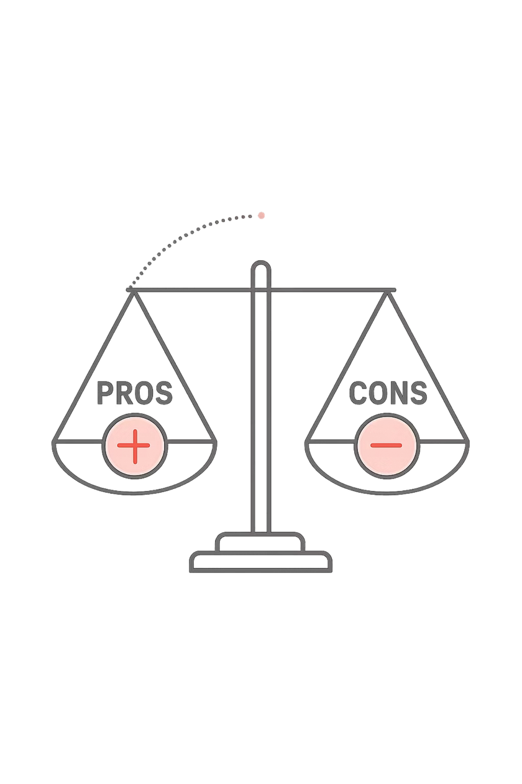
Advantages & Limitations
✓ Advantages
⚠ Limitations
Simple and beginner-friendly design
Efficient dynamic memory usage
Easier insertion and deletion operations
Practical programming skill development
Real-world application understanding
No graphical user interface
Console-based only
Temporary data storage
No file handling
Lacks user authentication
No database integration
Notes:
8

Slide 9

Conclusion
This Library Management System provides valuable hands-on experience applying programming concepts to real-world scenarios.
01
02
Learning Achievement
Functional System
Mastered linked lists, pointers, and dynamic memory allocation through practical implementation.
Built working system performing all essential library operations with organized structure.
03
Foundation for Growth
Strong base for future projects with potential enhancements like file handling and GUI.
Notes:
9

Slide 10
Thank You 💗
.
Notes:
10

